Slide 1
Interactive Data Visualization
Mod.100/1

Slide 2
Outline

Visual Analytics Overview
Visual Analytics Process, Building Blocks, Applications, Challenges and Opportunities, Human Analytical reasoning.

Interactive Visualization
Fundamentals of interaction and interactive visualization Tools.

Building Interactive Visualization in Python
How to build interactive visualization apps in Python, Frameworks and libraries,

Visual Analytics research
Current research trends in Visual Analytics.

Slide 3
Visual Analytics - recall
Visual Analytics is the science of analytical reasoning facilitated by interactive visual interfaces.
Visual analytics combines automated analysis techniques with interactive visualization for an effective understanding, reasoning and decision making on the basis of very large and complex datasets.

Slide 4
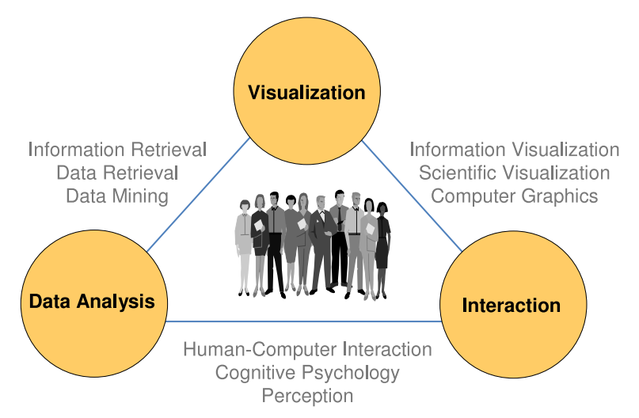
Visual Analytics as the interplay between Visualization, Data Analysis, Interaction, and Humans Capabilities.
Visual Analytics - recall
Source [1]

Slide 5
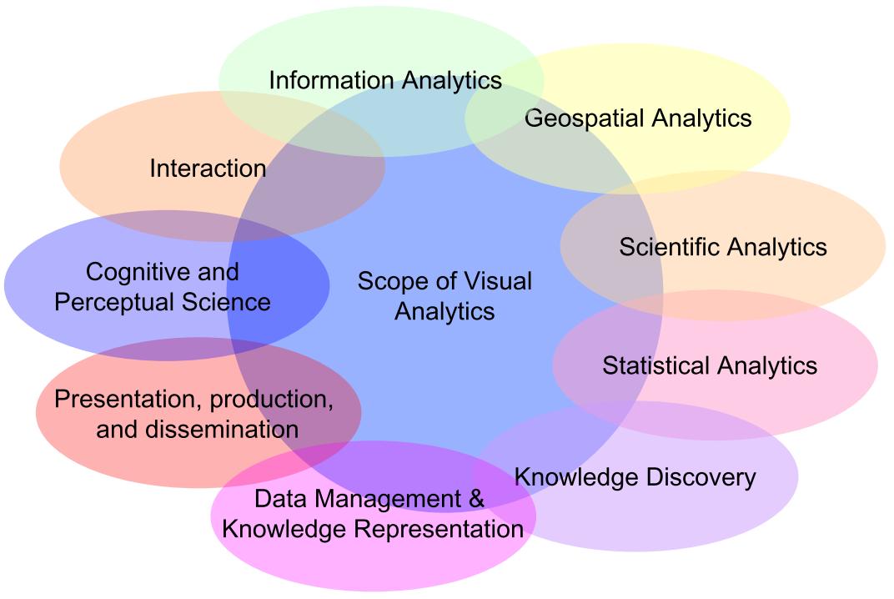
Multi-disciplinary area.
Visual Analytics - Scope
Source [2]

Slide 6
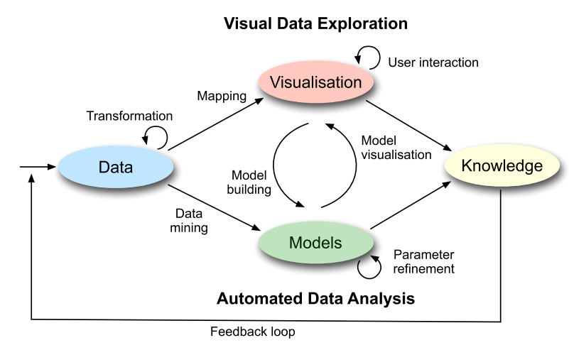
Visual Analytics - Process
Coupling automated analysis methods and interactive visual representations.
Integration between data, visualization, models, and users in order to discover knowledge.
Source [3]

Slide 7
Visual Analytics - Process
Heterogeneous data sources need to be integrated before visual or automatic analysis methods can be applied.
The first step is to pre-process and transform the data to drive different representations – Transformation.
After transformation, the analyst may choose between applying visual or automatic analysis methods.
If automated analysis, data mining methods are applied to generate models of the original data.
Then, analyst has to evaluate and refine the model by interacting with data.

Slide 8
Visual Analytics - Process
Visualizations allow the analyst to interact with the automatic methods by modifying parameters or selecting other analysis algorithm.
Model visualization can then be used to evaluate the findings of the generated models.
Findings in the visualizations can be used to steer model building in the automatic analysis.
It is necessary to analyse the data according to its value of interest, showing the most relevant aspects of the data, and at the same time providing interaction models, which allow the user to get details of the data on demand.

Slide 9
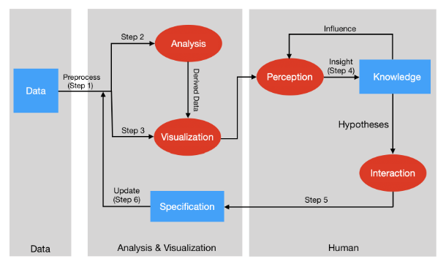
Visual Analytics - Process
Visual Analytics process as a sense-making loop
Source [4]

Slide 10
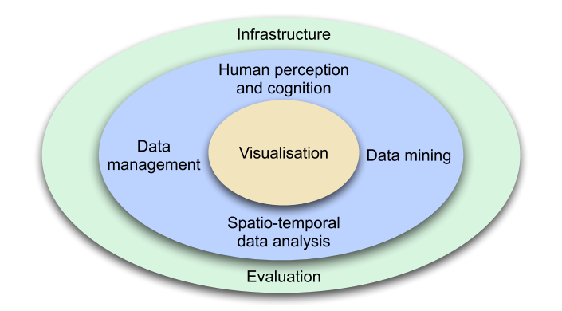
Visual Analytics – Building Blocks
Infrastructure:
Infrastructure is concerned with linking together all the processes functions and services required by visual analytic applications
Perception and Cognitive Aspects:
represent the more human side of visual analytics.
Cognition is the ability to understand visual information, making inferences largely based on prior learning
Data Management:
Heterogeneity of data source
Different data types
Data Stream
Working under Pressure
Time Consuming activities
Data Mining:
Computational methods to automatically extract valuable information from raw data by means of automatic analysis algorithms.
Space and Time:
The analysis of data with references both in space and in time
Visualization:
Means to communicate data and analysis results
Monitor other processes
Evaluation:
Assess the effectiveness, efficiency , current innovative and user acceptance of these innovations in a standard way.
Source [3]

Slide 11
Visual Analytics - Applications
Visual Analytics is essential in application areas where large information spaces have been processed and analysed:
Physics and Astronomy
Monitoring Climate and Weather
Emergency Management
Security and Geo-graphics
Investigation in Large Datasets
Biology and Medicine
Computer tomography and ultrasound imaging
Bioinformatics
Business Intelligence
Smart Manufacturing
Industry 4.0

Slide 12
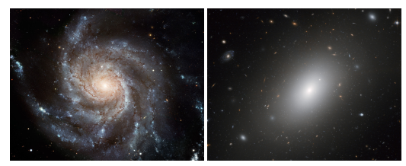
Astronomy
Visual Analytics - Applications
With common data analysis techniques, astronomers can separate relevant data from noise, analyze similarities or complex patterns, and gain useful knowledge about the universe.
The visual analytics approach can significantly support the process of identifying unexpected phenomena inside massive and dynamic data streams.
Source [5]

Slide 13
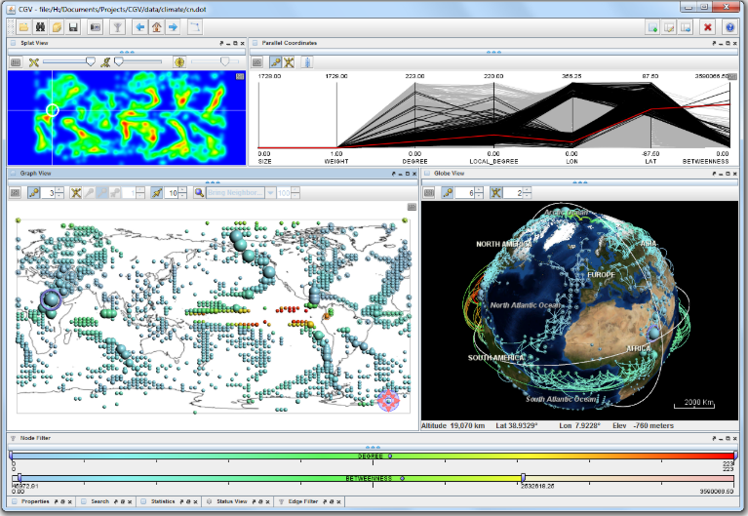
Climate: Visual support simulation of climate models (interactive graph visualization)
Visual Analytics - Applications
Source [3]

Slide 14
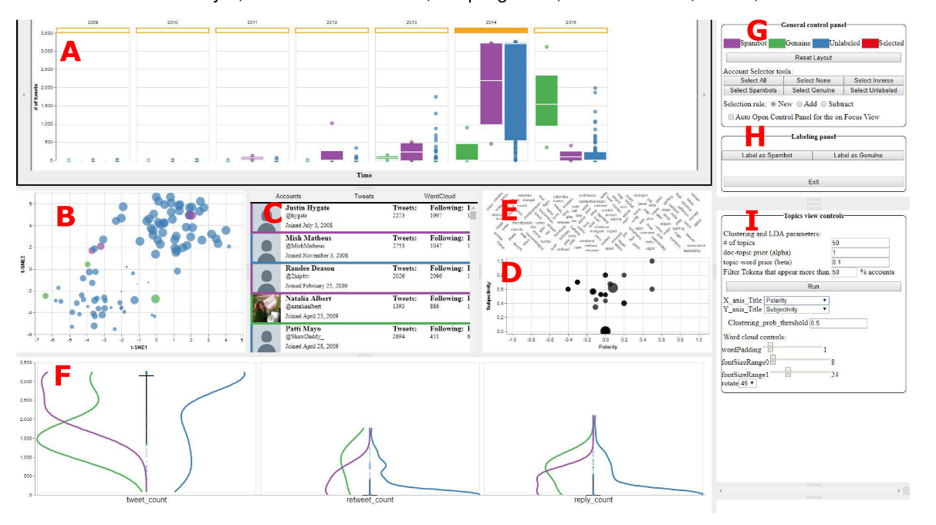
Social Media: VASSL: A Visual Analytics Toolkit for Social detecting and labelling Spambot
Visual Analytics - Applications
the timeline view,
the dimensionality reduction view,
the user/tweet detail views,
&
the topics view (clustering / words),
the feature explorer view,
the general control panel,
the labeling panel,
the control panels for all the views (the opened control panel in the figure is for topics clustering view).
Source [6]

Slide 15
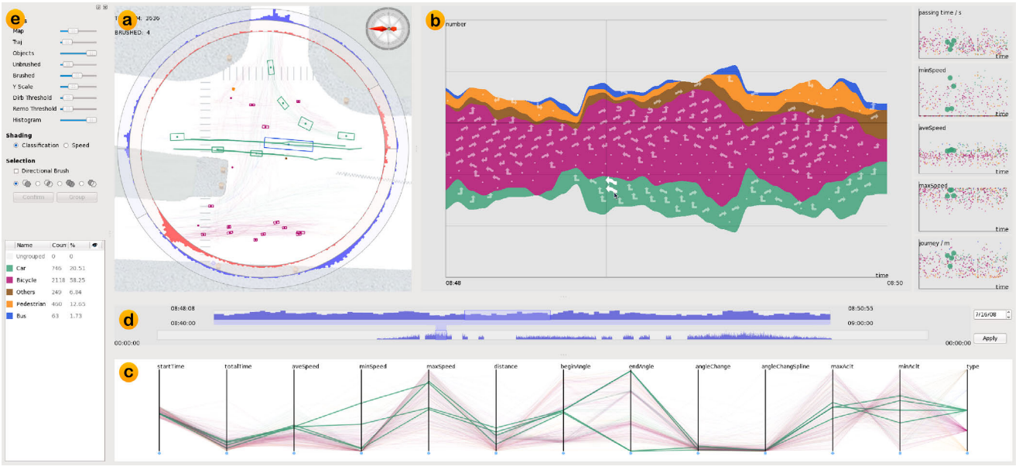
Traffic Data: Visual Trajectory Analytics on Traffic Data at Road Intersections
Visual Analytics - Applications
Spatial traffic view showing geometrical trajectory information
Temporal views of ThemeRiver and scatterplots
Parallel coordinates plot showing multiple properties of the multi-dimensional data
Time sliders for two-level time range selection;
Control panel for system parameter settings and data classification
Source [7]

Slide 16
Visual Analytics – Challenges and Opportunities
Challenge | Description
Scalability | Data volume, variety, velocity challenges for analysis
Available Information space | Data volume exceeds available pixels space
Visual Representations | Volume and variety – Traditional visualizations become unintelligible
Interoperability | Variety , faulty, missing or inconsistent data needs to be considered to avoid errors during analysis
Multidimensional data | Variety, Drawing insights across many dimensions requires new techniques for dimensionality reduction
Network or relational data | Variety and volume, graphs drawing quickly become unintelligible hairballs
Workflow and real time analysis | Velocity, Dynamic data, how to create representations of changing and new data

Slide 17
Visual Analytics
Uses Visualization and Interactive techniques to integrate expert humans judgment in the data analysis process.
Data Visualization
Interaction Techniques

Slide 18
Visual Analytics – Analytical reasoning
The core idea of Visual Analytics is to integrate human cognitive, perceptual, and reasoning abilities and their knowledge into the analysis process to gain insight from data that is difficult to explore with pure visualization or analysis techniques.
How do we understand a visualization?
How do we respond to a visualization?
Analytical reasoning encompasses different kinds of reasoning, such as deductive, inductive, and Abductive which are based on rational, logical analysis and evaluation of data.

Slide 19
Deductive
Visual Analytics – Analytical reasoning
Logic
If A then B
A, therefore B
Not B, therefore not A
When you have eliminated the impossible, whatever remains, however improbably, must be the truth
Correlation is not causation

Slide 20
Inductive
Visual Analytics – Analytical reasoning
If true for x, then true for x+1
Generalizations
Extrapolation
Interpolation
Allows us to infer missing data

Slide 21
Abductive
Visual Analytics – Analytical reasoning
Forming a conclusion from the information that is known.
E.g. detective's identification of a criminal by piecing together evidence at a crime scene.
Asking why?
Modelling.

Slide 22
Visual Analytics – Terms
Term | Summary
Data Visualization | Creating visual representations of data, which include information visualization and scientific visualization.
Data Analysis | Process of analysing data with the goal of discovering useful information by applying statistical procedures and/or logical techniques. In statistics, data analysis is divided into confirmatory and exploratory data analysis.
Data Mining | The process of discovering patterns in large data sets.
Visual Analytics | The science of analytical reasoning facilitated by interactive visual interfaces.

Slide 23
Interactive Visualization

Slide 24
Interactive Visualizations
They focus on graphic visualizations and improving the way we can access and interact with information.
Used by analytics and business intelligence tools.
Mostly, as part of interactive dashboards for quick and easy way to understand insights based on changing data.

Slide 25
Interactive Visualizations
For a visualization to be considered interactive, it must have:
An aspect of human input—clicking on a button, moving a slider, etc.
A response time quick enough to show a real relation between input and output.

Slide 26
Interactive Visualizations
Issues Regarding Interactions:
Many categories of techniques
Navigation, selection, filtering, reconfiguring, encoding, connecting, or combinations of them.
Many Spaces in which the interaction can be applied
Scree/Pixel , data, data structures, graphical objects, graphical attributes, visualization structure

Slide 27
Interactive Visualization Tools in Python
Interactive Visualizations
Plotly
Dash
Bokeh
mpld3
pygal
HoloViews

Slide 28
Building Interactive Visualization
Building Interactive Visualization in Python ( Dash + Plotly)

Slide 29
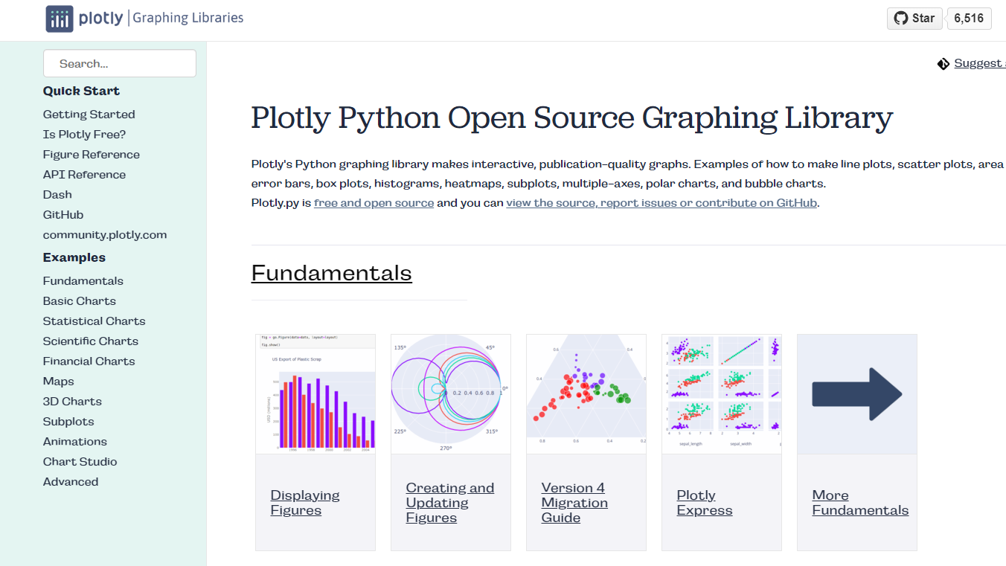
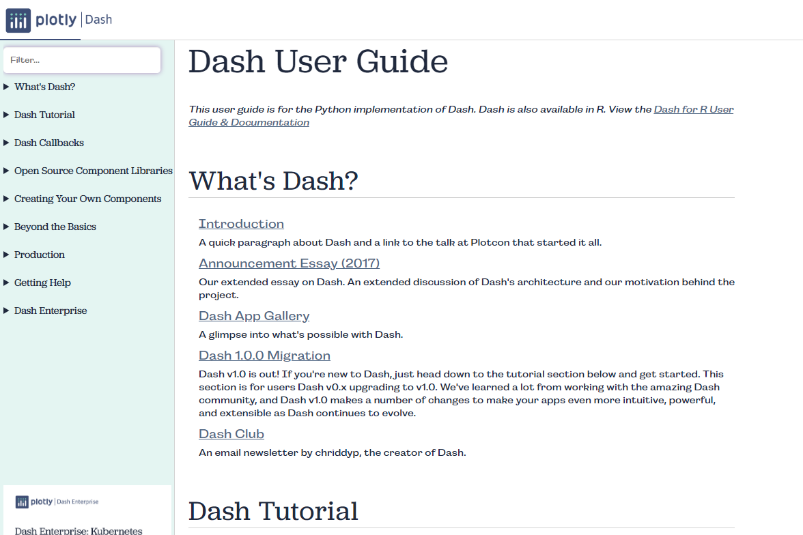
Building Interactive Visualization - Libraries
Plotly: for making interactive graphs
Dash: framework for building web applications

Slide 30
Building Interactive Visualization - Dash Basics
A Python framework for building web applications.
Written on top of Flask, Plotly, and React.
Ideal for building data visualization apps with highly custom user interfaces in pure Python.
Dash apps are rendered in the web browser and can be deployed to servers and shared through URLs.
Cross-platform.
Dash is used to create interactive Dashboards in Python.

Slide 31
Building Interactive Visualization - Dash Basics
Dash apps are composed of two main parts:
Layout: describes the layout and how the application looks like.
Interaction: describes the interactivity of the application.
No need to know HTML or CSS to use Dash.
Most of the html tags are provided as python classes.
Two distinct components:
dash_html_components : a component for every html tags
dash_core_components: high-level and interactive components

Slide 32
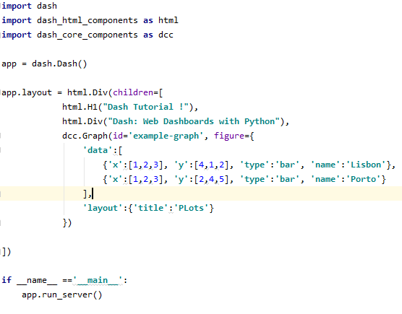
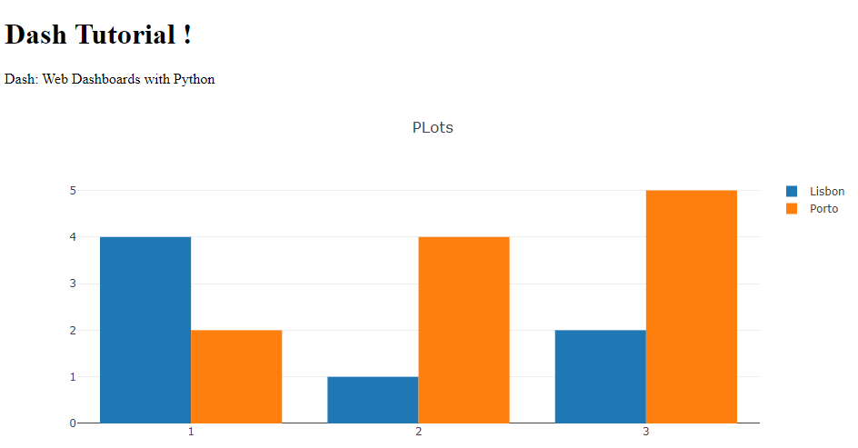
Building Interactive Visualization - Create Dash App
Create Dash app object
Edit the app’s layout
Adding html elements
Adding graphs
Run the app server

Slide 33
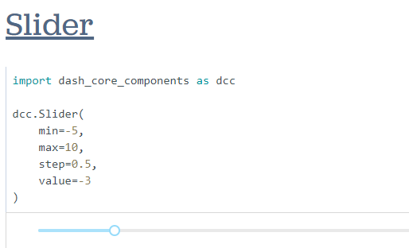
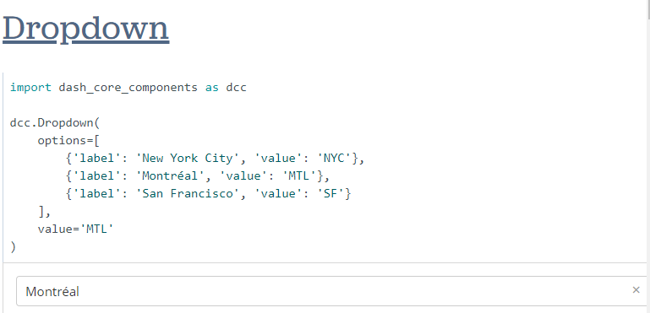
Building Interactive Visualization - Dash Components
Components for interactive user interfaces
https://dash.plotly.com/dash-core-components

Slide 34
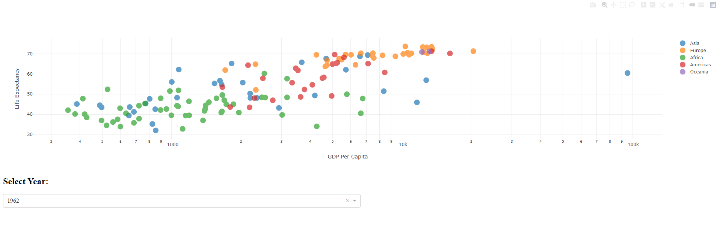
Building Interactive Visualization - Dash Callbacks
How to make your Dash apps interactive?
Python functions that are automatically called by Dash whenever an input component’s property changes
https://dash.plotly.com/basic-callbacks

Slide 35
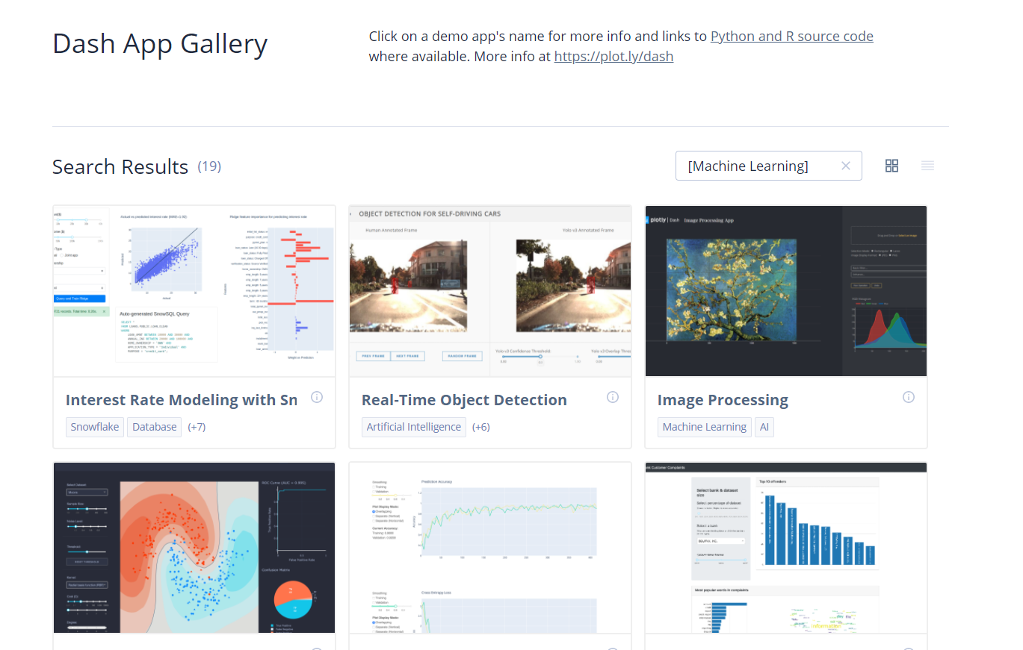
Building Interactive Visualization – Examples
https://dash-gallery.plotly.host/Portal/?search=[Machine%20Learning]

Slide 36
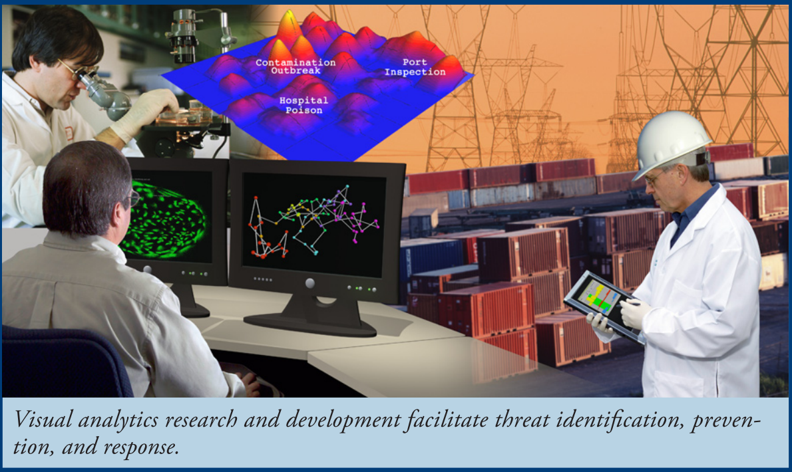
Visual Analytics Research
Research Trends

Slide 37
Research topics:
Visual Analytics Research
Interactive Visual Analytics
VA.Lab at Georgia Tech https://gtvalab.github.io/
Interactive Machine Learning

Slide 38
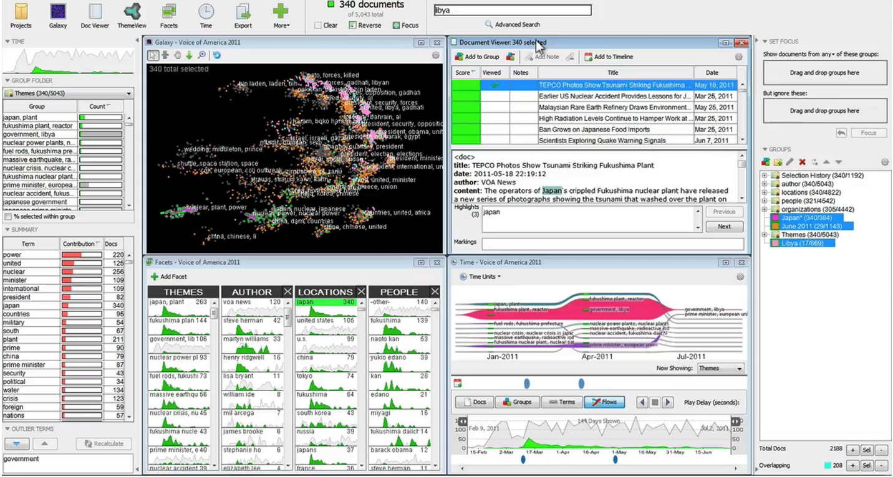
Research topics: Integrating Machine Learning into Visual Analytics
Visual Analytics Research
IN-SPIRE: VA system for text corpora, combines computational metrics with interactive visualizations.
Text analytics and topic modelling, displays documents clustered by similarity and using dimension reduction techniques to encodes relative similarities as distance.
Source [8]

Slide 39
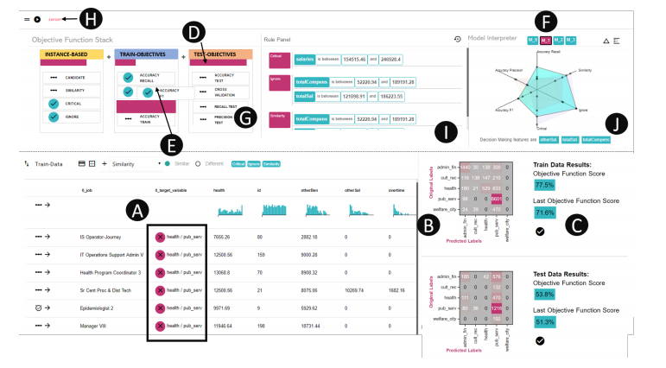
Research topics: Interactive Construction of Objective Functions for Classification Tasks
Visual Analytics Research
QUESTO: an approach that allows users to generate objective functions for classification problems through an interactive visual interface.
The approach adopts a semantic interaction design in that user interactions over data elements in the visualization are translated into objective function terms.
https://gtvalab.github.io/projects/questo.html
Source [9]

Slide 40
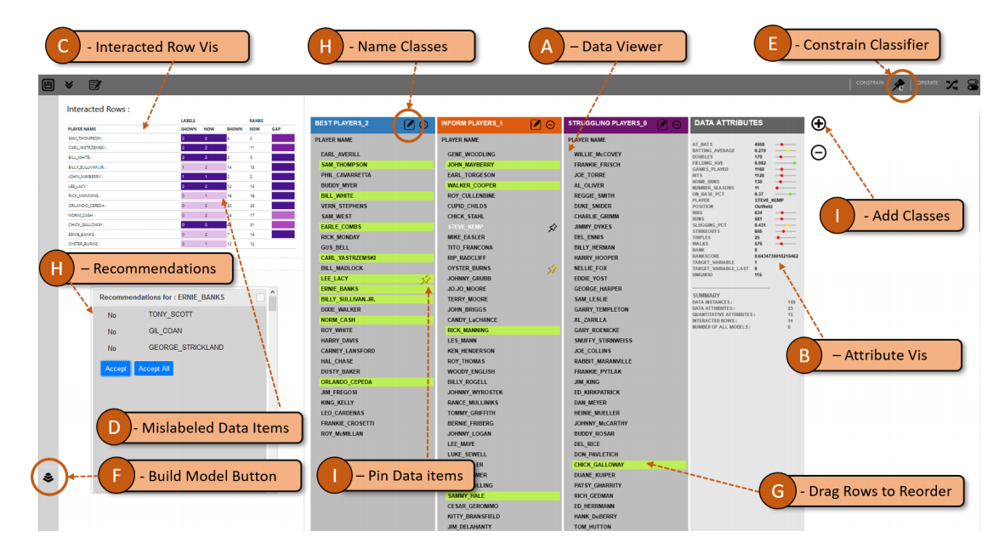
Research topics: Visual Analytics for Model Space Navigation
Visual Analytics Research
Gaggle, a multi-model visual analytic system that enables users to interactively navigate the model space, translating user interactions into inferences, simplifies working with multiple models.
https://gtvalab.github.io/projects/gaggle.html
Source [10]

Slide 41

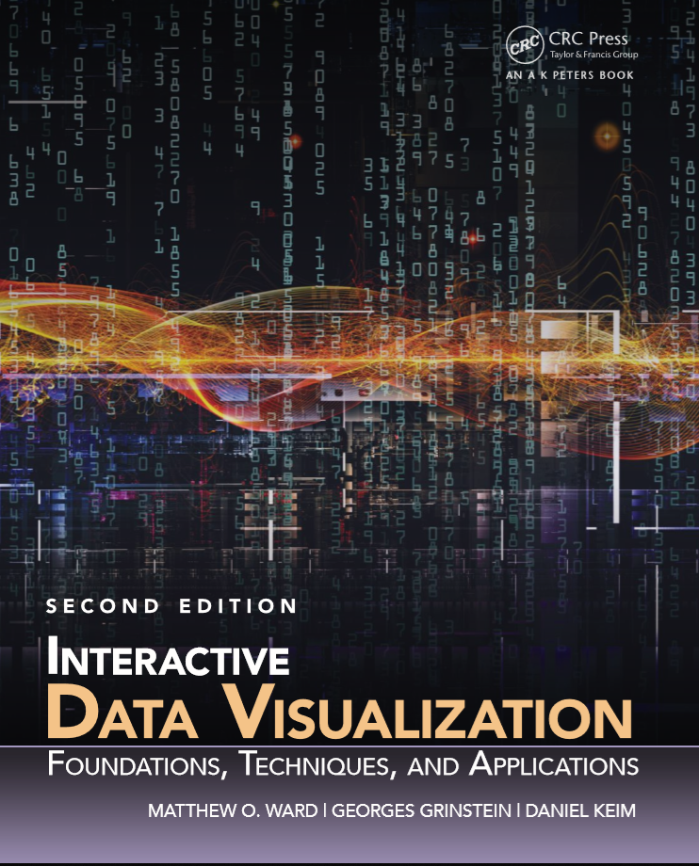
References
Interactive Visualization
Books

Slide 42
References
Interactive Visualization
Papers
D. A. Keim, F. Mansmann, A. Stoffel, and H. Ziegler, “Visual Analytics,” in Encyclopedia of Database Systems, L. LIU and M. T. ÖZSU, Eds. Boston, MA: Springer US, 2009, pp. 3341–3346.
C. Mehrotra, N. Chitransh, and A. Singh, “Visual Analytics: Scope and Challenges,” Lect. notes Comput. Sci., no. 4404, pp. 76–90, 2008.
E. Aharon-Shalom and A. Heller, Mastering the information age : Solving problems with Visual Analytics- VisMaster Book, vol. 129. 2010.
W. Cui, “Visual Analytics: A Comprehensive Overview,” IEEE Access, vol. 7, no. June, pp. 81555–81573, 2019.
J. Kremer, K. Stensbo-Smidt, F. Gieseke, K. S. Pedersen, and C. Igel, “Big Universe, Big Data: Machine Learning and Image Analysis for Astronomy,” IEEE Intell. Syst., vol. 32, no. 2, pp. 16–22, 2017.
M. Khayat, M. Karimzadeh, J. Zhao, and D. S. Ebert, “VASSL: A Visual Analytics Toolkit for Social Spambot Labeling,” IEEE Trans. Vis. Comput. Graph., vol. 26, no. 1, pp. 874–883, 2020.
H. Guo, Z. Wang, B. Yu, H. Zhao, and X. Yuan, “TripVista: Triple Perspective Visual Trajectory Analytics and its application on microscopic traffic data at a road intersection,” IEEE Pacific Vis. Symp. 2011, PacificVis 2011 - Proc., no. May 2014, pp. 163–170, 2011.
A. Endert et al., “The State of the Art in Integrating Machine Learning into Visual Analytics,” Comput. Graph. Forum, vol. 36, no. 8, pp. 458–486, 2017.
S. Das, S. Xu, M. Gleicher, R. Chang, and A. Endert, “QUESTO: Interactive Construction of Objective Functions for Classification Tasks,” Eurographics Conf. Vis. 2020 M. Gleicher, T. Landesberger von Antburg, I. Viola, vol. 39, no. 3, 2020
S. Das, D. Cashman, and A. Endert, “Gaggle : Visual Analytics for Model Space Navigation,” in Graphics Interface Conference 2020, 2020.

Slide 43
References
Interactive Visualization
Websites
https://www.visualisingdata.com/resources/
https://www.cs.usfca.edu/~apjoshi/msds622/assignments/assignment5.html
https://plotly.com/python/
https://dash.plotly.com/
https://opensource.com/article/19/4/log-analysis-tools
https://stackify.com/best-log-management-tools/
https://medium.com/tensult/tools-for-log-analysis-461eb07c2d6b

Slide 44
References
Interactive Visualization
Online Courses
Interactive Python Dashboards with Plotly and Dash (Udemy)
Interactive Data Visualization with Bokeh (DataCamp)

Slide 45

Get In Touch
+351 253 510 580
www.ccg.pt
CCG-Centro-de-Computação-Gráfica
info@ccg.pt
Campus de Azurém
Centro de Computação Gráfica
4800-048 Guimarães
Portugal

Slide 46
Thanks

